Slide 1
Processor Architecture

Slide 2
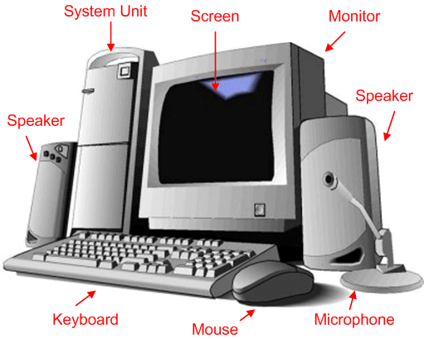

Slide 3
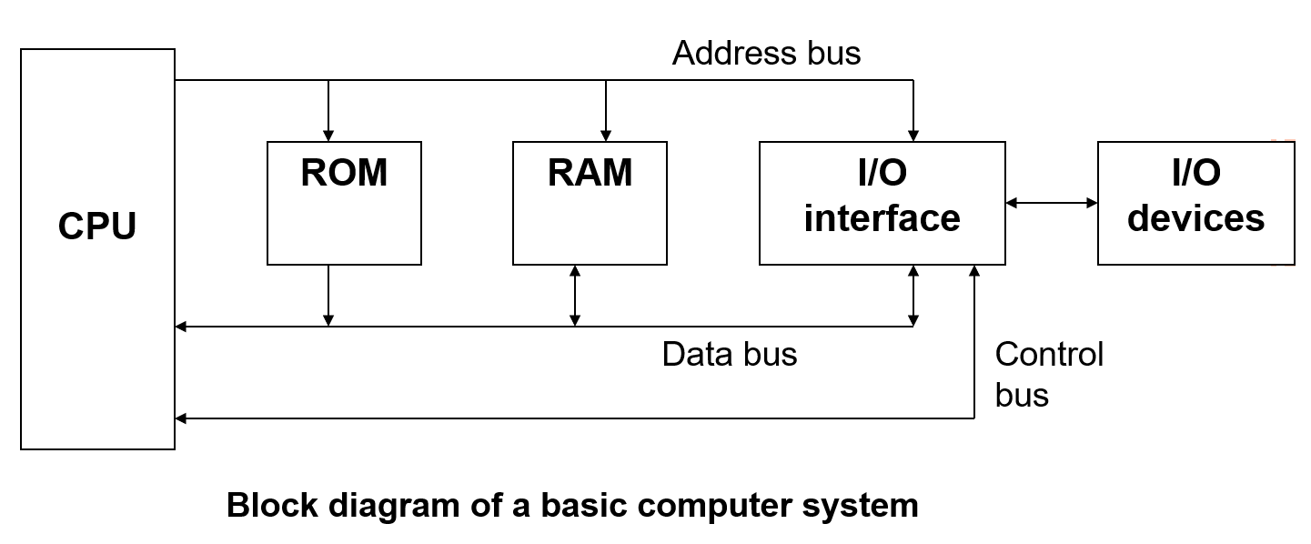

Slide 4
CPU - Central Processing Unit
the portion of a computer system that carries out the instructions of a computer program
the primary element carrying out the computer's functions. It is the unit that reads and executes program instructions.
The data in the instruction tells the processor what to do.

Slide 5
LDCO

Slide 6
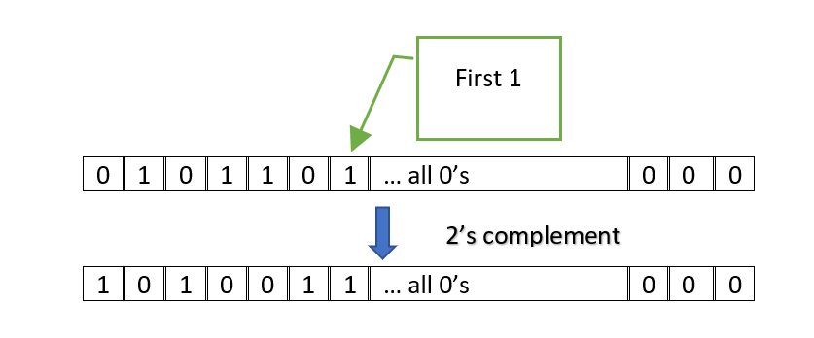

Slide 7
Grey code or Gray code
0 Ꚛ x ➔
1 Ꚛ x ➔

Slide 8
Grey code or Gray code
0 Ꚛ x ➔ x
1 Ꚛ x ➔ x
x Ꚛ x ➔ 0
x Ꚛ x ➔ 1

Slide 9
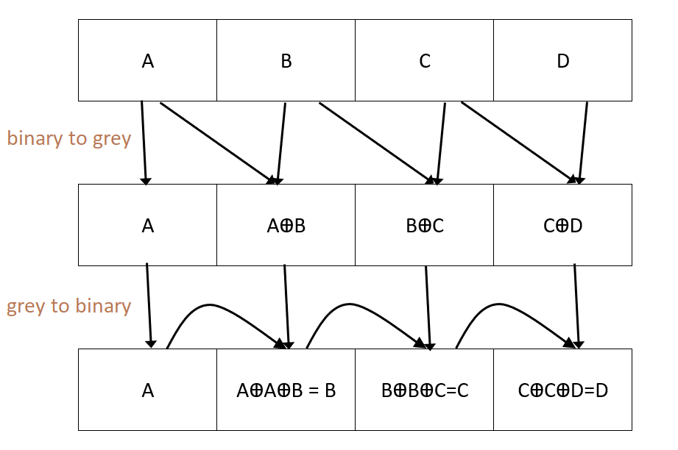

Slide 10
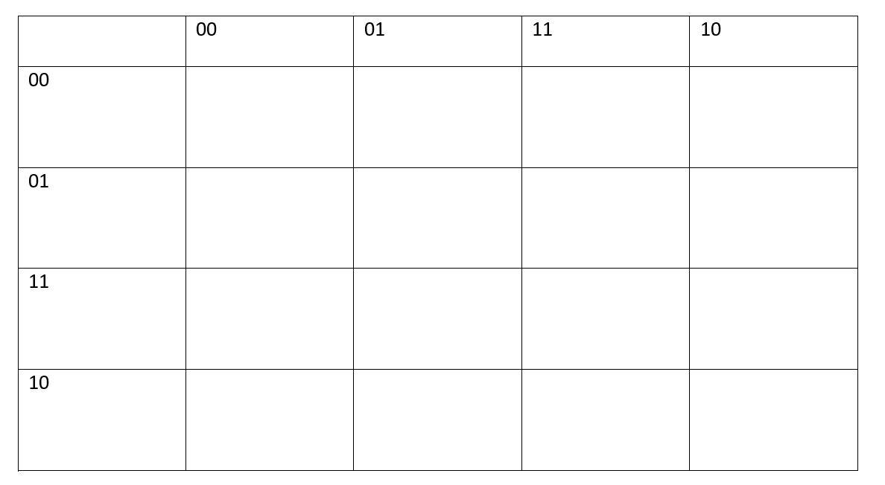

Slide 11
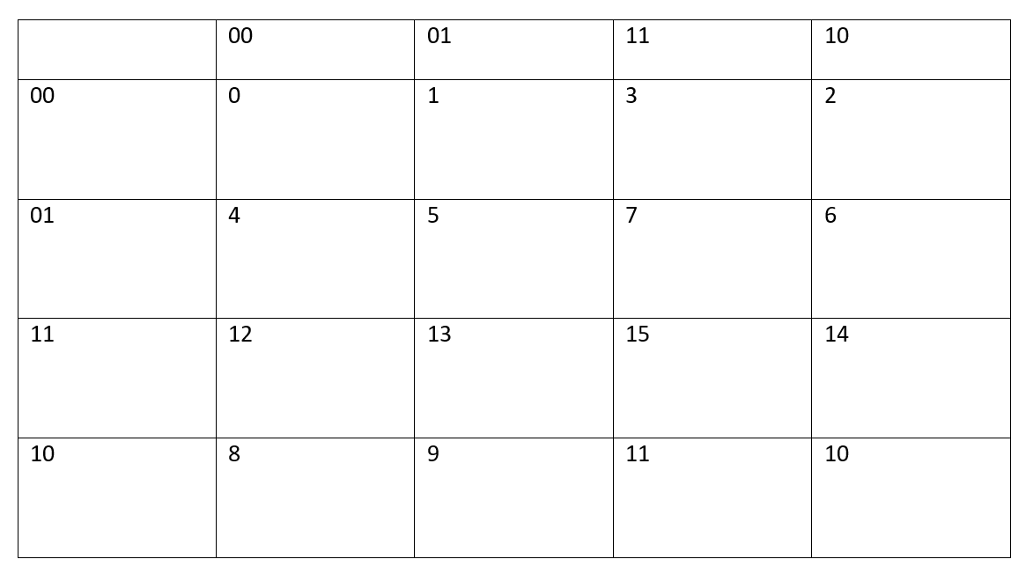

Slide 12
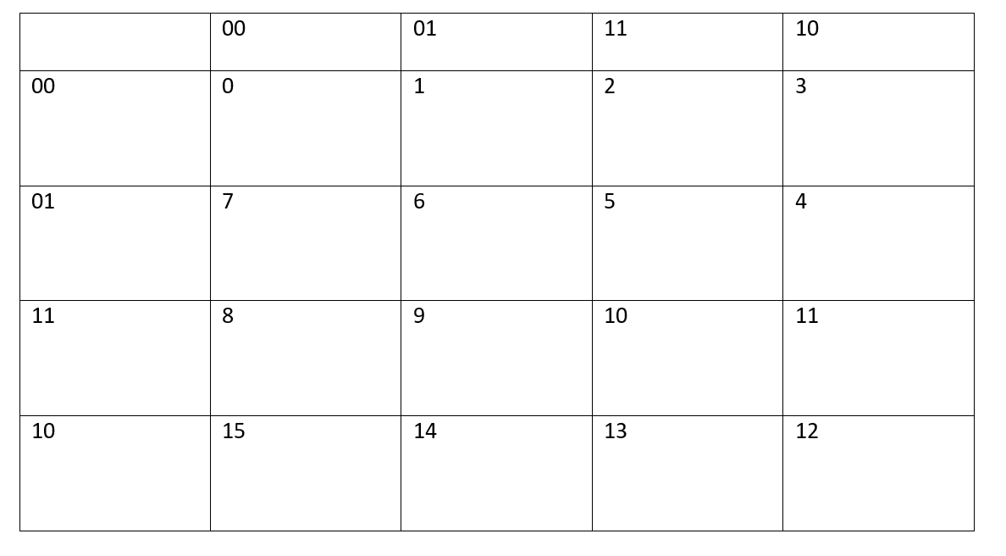

Slide 13
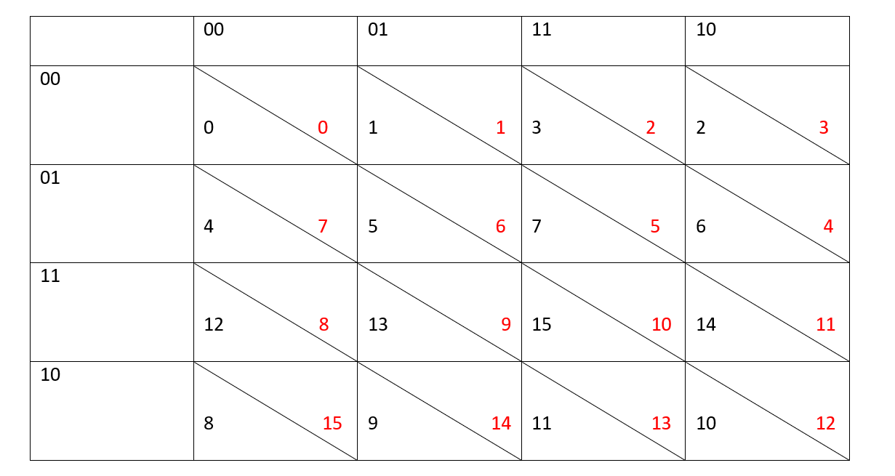

Slide 14
Binary | Decimal equivalent of binary | Gray | Decimal equivalent of gray
0000 | 0 | 0000 | 0
0001 | 1 | 0001 | 1
0010 | 2 | 0011 | 3
0011 | 3 | 0010 | 2
0100 | 4 | 0110 | 6
0101 | 5 | 0111 | 7
0110 | 6 | 0101 | 5
0111 | 7 | 0100 | 4
1000 | 8 | 1100 | 12
1001 | 9 | 1101 | 13
1010 | 10 | 1111 | 15
1011 | 11 | 1110 | 14
1100 | 12 | 1010 | 10
1101 | 13 | 1011 | 11
1110 | 14 | 1001 | 9
1111 | 15 | 1000 | 8

Slide 15
Binary | Unsigned number | Signed number – sign magnitude | Signed number- 1’s complement | Signed number- 2’s complement | Grey | Hexadecimal
0000 | 0 | 0 | 0 | 0 | 0 | 0
0001 | 1 | 1 | 1 | 1 | 1 | 1
0010 | 2 | 2 | 2 | 2 | 3 | 2
0011 | 3 |  |  |  | 2
0100 | 4
0101 | 5
0110 | 6
0111 | 7
1000 | 8 | -0 | -7 | -8 | 15 | 8
1001 | 9
1010 | 10
1011 | 11
1100 | 12
1101 | 13
1110 | 14 | -6 | -1 | -2 | 11 | E
1111 | 15

Slide 16
Binary | Unsigned number | Signed number – sign magnitude | Signed number- 1’s complement | Signed number- 2’s complement | Grey | Hexadecimal
0000 | 0 | 0 | 0 | 0 | 0 | 0
0001 | 1 | 1 | 1 | 1 | 1 | 1
0010 | 2 | 2 | 2 | 2 | 3 | 2
0011 | 3 | 3 | 3 | 3 | 2 | 3
0100 | 4 | 4 | 4 | 4 | 7 | 4
0101 | 5 | 5 | 5 | 5 | 6 | 5
0110 | 6 | 6 | 6 | 6 | 4 | 6
0111 | 7 | 7 | 7 | 7 | 5 | 7
1000 | 8 | -0 | -7 | -8 | 15 | 8
1001 | 9 | -1 | -6 | -7 | 14 | 9
1010 | 10 | -2 | -5 | -6 | 12 | A
1011 | 11 | -3 | -4 | -5 | 13 | B
1100 | 12 | -4 | -3 | -4 | 8 | C
1101 | 13 | -5 | -2 | -3 | 9 | D
1110 | 14 | -6 | -1 | -2 | 11 | E
1111 | 15 | -7 | -0 | -1 | 10 | F

Slide 17
#include <stdio.h> int main() { int i; for(i=-1215;i<-1210;i++) { printf("%d %u %x %c ---- ",i,i,i,i);
}
}

Slide 18
-1215 4294966081 fffffb41 A
-1214 4294966082 fffffb42 B
-1213 4294966083 fffffb43 C
-1212 4294966084 fffffb44 D
-1211 4294966085 fffffb45 E

Slide 19
#include <stdio.h> int main() { int i; unsigned int j; for(i=-1215;i<-1210;i++) { j=i; printf("%d %u %x %c ---- ",i,i,i,i); printf("%d - ascii\n",j%128); } return 0; }

Slide 20
-1215 4294966081 fffffb41 A ---- 65 - ascii
-1214 4294966082 fffffb42 B ---- 66 - ascii
-1213 4294966083 fffffb43 C ---- 67 - ascii
-1212 4294966084 fffffb44 D ---- 68 - ascii
-1211 4294966085 fffffb45 E ---- 69 - ascii

Slide 21
A | B | A | B | A+B | Unsigned A | Unsigned B | Signed A+B | Unsigned A+B
12 | 13 | 001100 | 001101 | 011001 | 12 | 13 | 25 | 25
12 | -13 | 001100 | 110011 | 111111 | 12 | 51 | -1 | 63
-12 | 13 | 110100 | 001101 | 1-000001 | 52 | 13 | 1 | 64+1
-12 | -13 | 110100 | 110011 | 1-100111 | 52 | 51 | -25 | 64+39

Slide 22
A | B | A | B | A+B | Unsigned A | Unsigned B | Signed A+B | Unsigned A+B
14 | 16 | 001110 | 010000 | 011110 | 14 | 16 | 25 | 25
14 | -16 | 001110 | 110000 | 111110 | 12 | 51 | -1 | 63
-14 | 16 | 110010 | 010000 | 1-010010 | 52 | 13 | 1 | 64+1
-14 | -16 | 110010 | 110000 | 1-100010 | 52 | 51 | -25 | 64+39

Slide 23
int main()
{
for(int x=0;x>=0;x+=100000)
{
printf(“%d “,x);
}
return(1);
}

Slide 24
int main()
{
int x=2147483646,y=5;
printf("%d %u\n",x+y,x+y);
}

Slide 25
int main()
{
int x=2147483646,y=5;
printf("%d %u\n",x+y,x+y);
}
Output:
-2147483645 2147483651

Slide 26
A | B | A Binary | B Binary | A+B Binary | Unsigned A | Unsigned B | Signed A+B | Unsigned A+B
52 | 31
23 | 43
44 | -12
-28 | 6

Slide 27
A | B | A Binary | B Binary | A+B Binary | Unsigned A | Unsigned B | Signed A+B | Unsigned A+B
52 | 31 | 110100 | 011111 | 1-010011 | 52 | 31 | 64+19 | 64+19
23 | 43 | 010111 | 101011 | 1-000010 | 23 | 43(-21) | 2 | 64+2
44 | -12 | 101100 | 110100 | 1-100000 | 44 | 52 | 32 | 64+32
-28 | 6 | 100100 | 000110 | 101010 | 36 | 6 | -22 | 42

